Slide 1
機器學習與實作 坦克車
組員 : 侯勝發、溫世新、顧和庭

Slide 2
專案需求
功能需求:
遊戲引擎-坦克車(TankMan):
遊戲機制:
2~6位玩家進行團隊對抗賽，GreenTeam 為綠色坦克車，BlueTeam 為藍色坦克車，每隊最多3人。透過回傳遊戲指令，操控玩家與射擊砲彈，場上會有各類補給站，可以移動坦克車經過補給站獲取資源。
遊戲目標 : 時間內殲滅敵對，或高分隊伍獲勝。分數計算方式： 敵方失去的生命次數+20分。 每擊中一次牆壁+1分。擊破牆壁*5分。
失敗條件 : 生命歸零，或遊戲時間結束時分數較敵隊低。

Slide 3
專案需求
功能需求:
ML model-Decision Tree:
樣本收集 :
透過兩個AI(1P,2P)遊玩，收集遊戲狀態增加更多特徵數量
預測 :
利用決策樹，根據不同特徵進行預測

Slide 4
專案需求
效能需求:
遊戲FPS : 120

Slide 5
專案需求
介面需求:
外部介面 :
遊戲介面 :
牆壁
坦克
燃油站
彈藥站

Slide 6
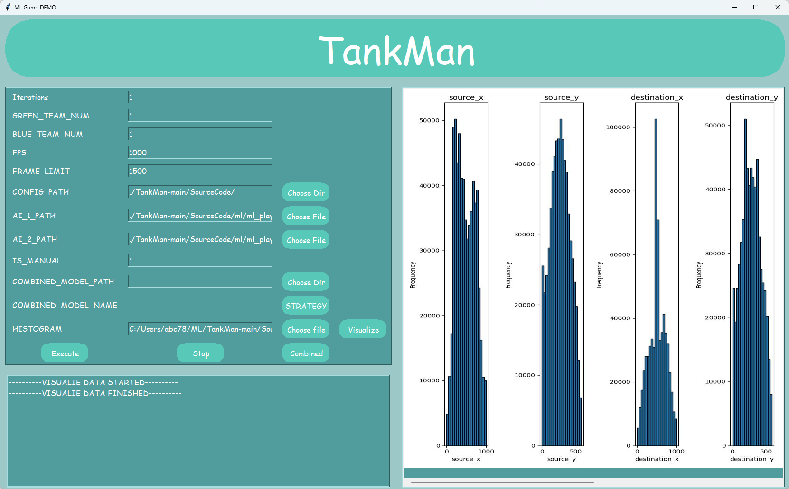
專案需求
介面需求:
外部介面 :
GUI介面:
設定遊戲參數
Terminal output
視覺化結果
功能按鈕
執行遊戲
視覺化
資料合併
遊戲參數
Terminal output

Slide 7
專案需求
介面需求:
內部介面 :
model : 使用pickle儲存
Features : 使用pickle儲存
Targets : 使用pickle儲存
Record : 使用csv儲存

Slide 8
專案需求
限制:
環境版本:
Python : 3.9.13
模組版本:
MLGAME : 10.4.5.2、PyGame : 2.5.2、scikit-learn : 1.5.0
作業系統:
WINDOWS 11
硬體規格:
CPU : 11th Gen Intel(R) Core(TM) i7-1165G7 @ 2.80GHz
GPU : Intel(R) Iris(R) Xe Graphics
RAM: 16GB

Slide 9
專案需求
限制:
模型預測時間需小於0.0083 (s/frame)。

Slide 10
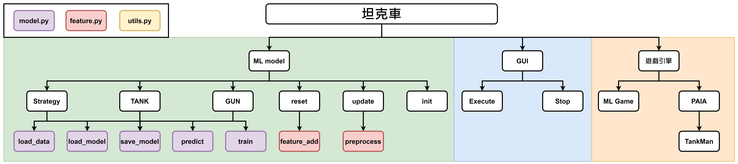
專案架構(06/12)
Breakdown

Slide 11
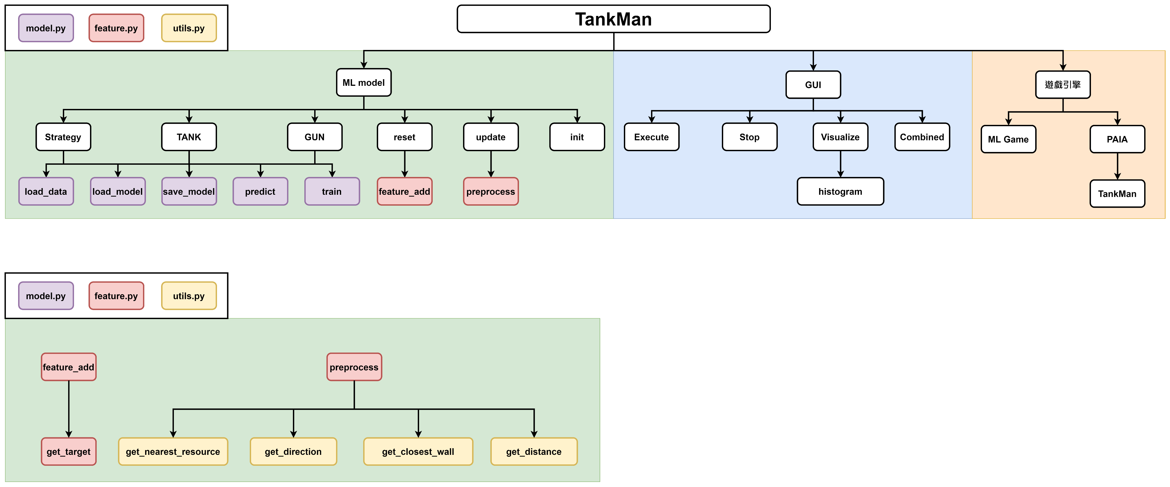
專案架構(06/19)
Breakdown

Slide 12
專案架構(06/19)
Breakdown

Slide 13
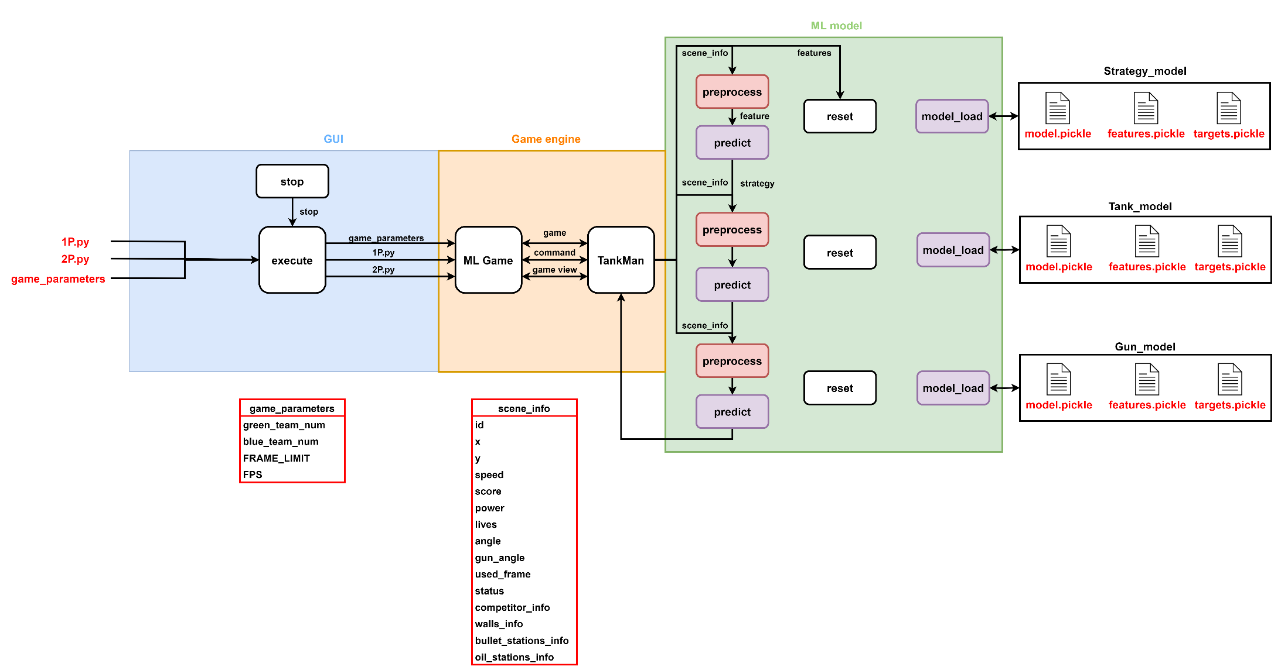
專案架構(06/12)
Architecture

Slide 14
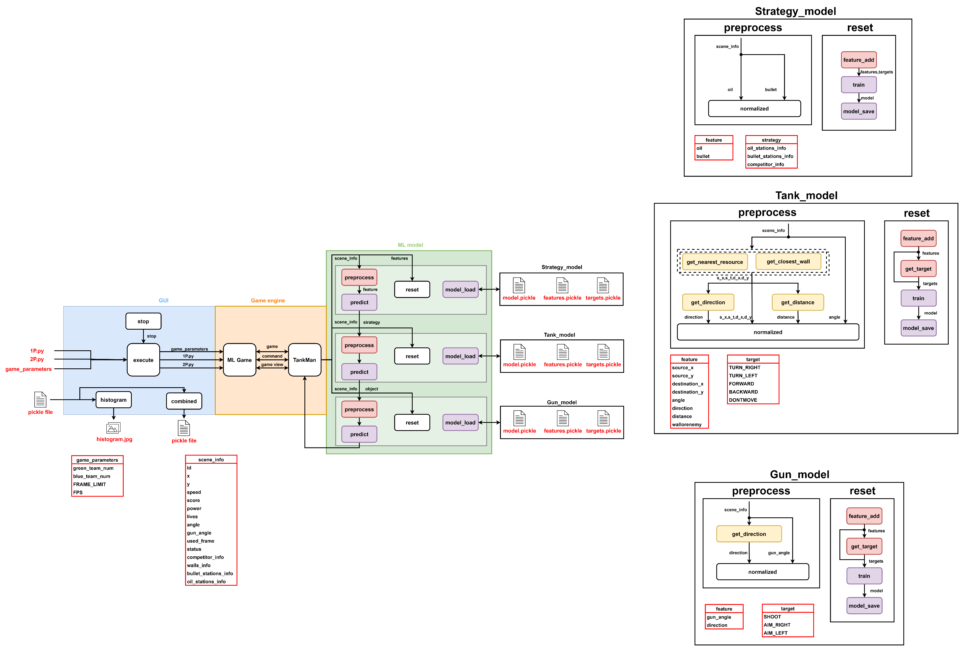
專案架構(06/19)
Architecture

Slide 15
專案架構(06/19)
Architecture

Slide 16

專案架構(06/19)
Architecture

Slide 17
專案架構(06/19)
Architecture

Slide 18

專案架構(06/19)
Architecture

Slide 19
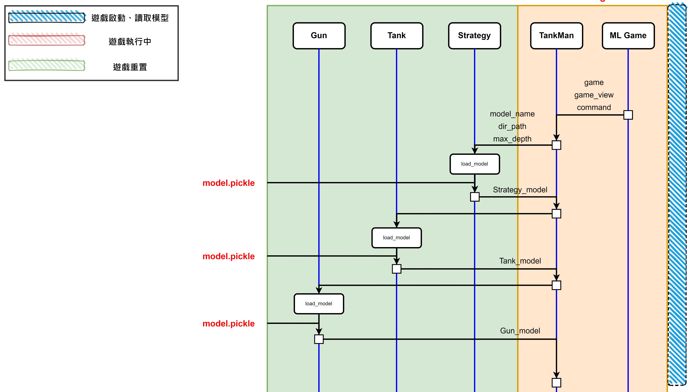
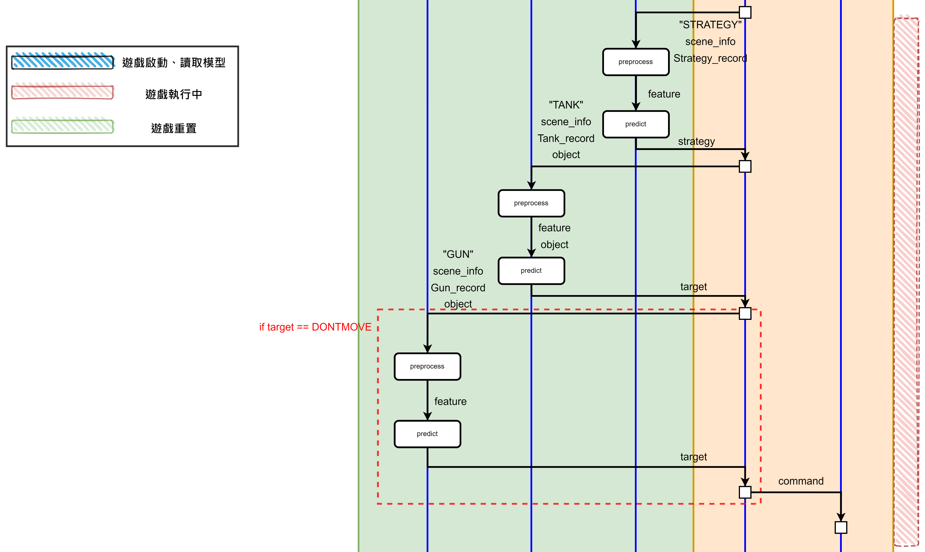
專案架構
MSC

Slide 20
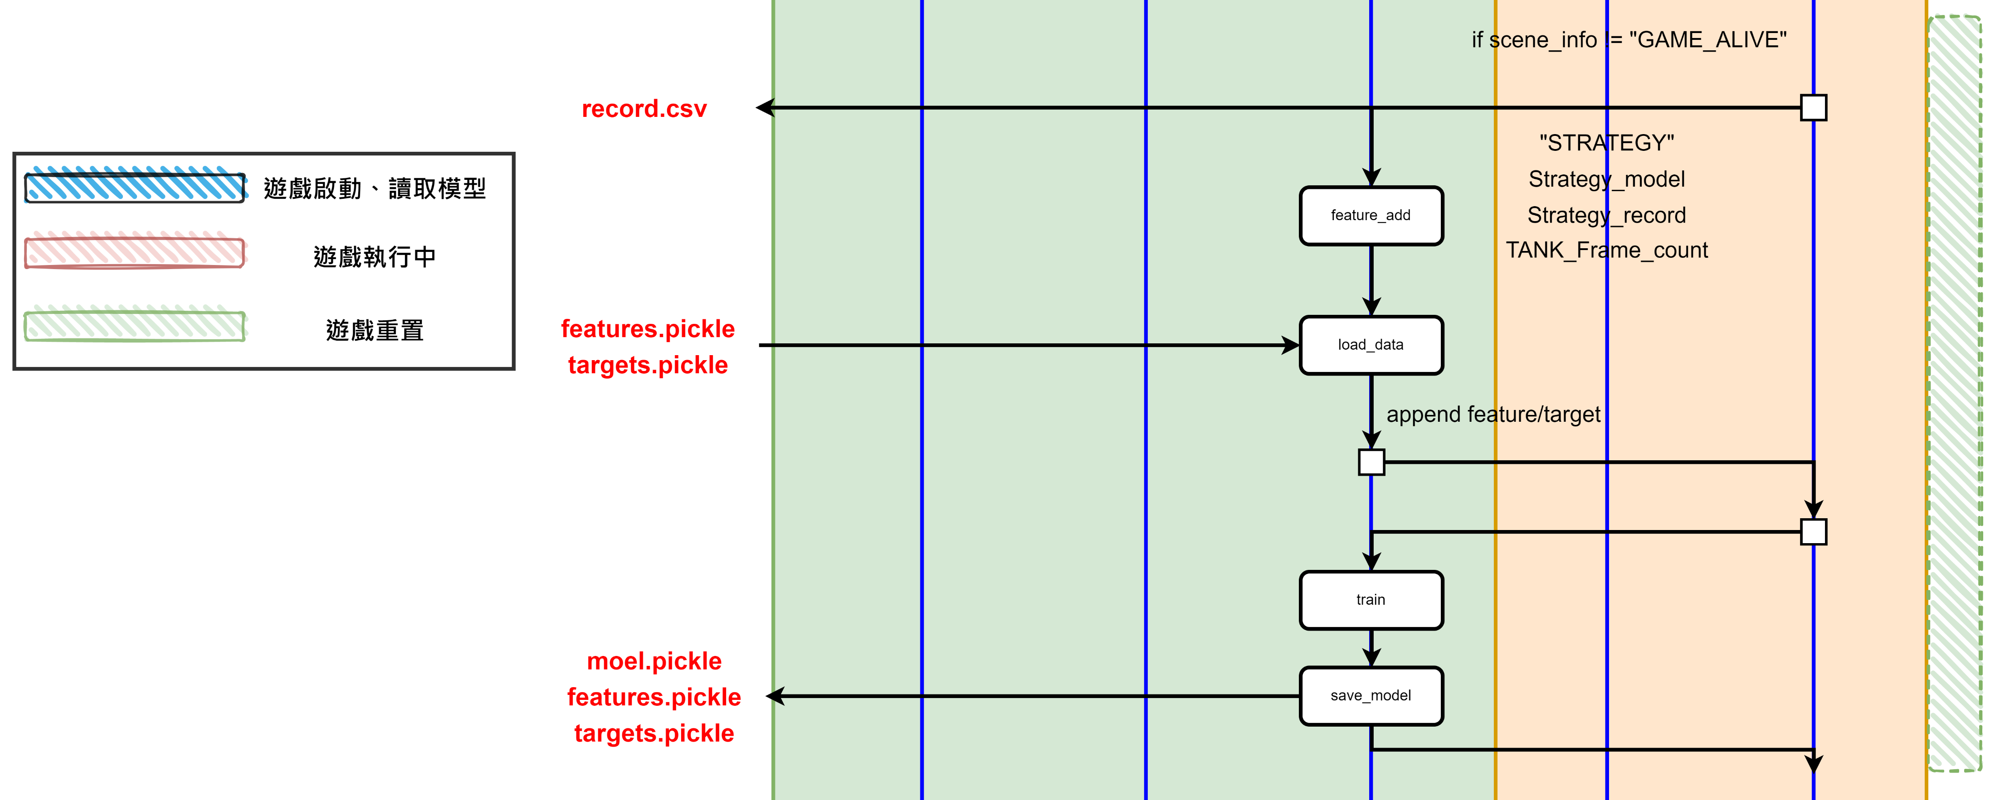
專案架構
MSC

Slide 21
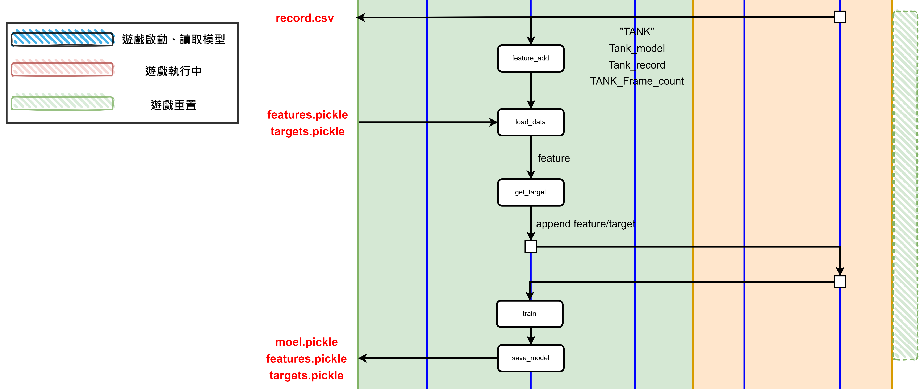
專案架構
MSC
Strategy_model 訓練

Slide 22
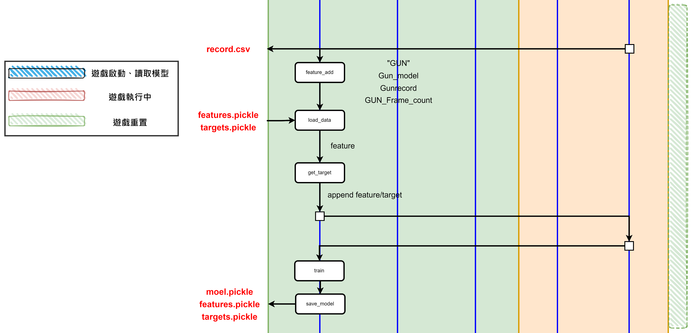
專案架構
MSC
Tank_model 訓練

Slide 23
專案架構
MSC
Gun_model 訓練

Slide 24
API
DecisionTreeClassifier_Model
DecisionTreeClassifier_Model
屬性 | model_name (str): The name of the model. dir_path (str): The directory path where the model and data files are stored. max_depth (int, optional): The maximum depth of the decision tree. Defaults to None. features (list): The features used for training the model. targets (list): The target values used for training the model.
方法 | load_data(): Loads the features and targets data from pickle files or default values. load_model(): Loads the model from a pickle file or creates a new one. save_model(): Saves the features, targets, and model to pickle files. predict(): Predicts the target value for a given feature. train(): Trains the model using the loaded features and targets.

Slide 25
API
DecisionTreeClassifier_Model-Load_data
Load_data
輸入 | 無
輸出 | 無
參數 | DIR(str) : 模型儲存資料夾 Defaultdict(dict) : 用來初始化各模型特徵與目標的字典。
方法 | os.path.dirname() pickle.load()
情境 | 讀取資料夾中資料集資料(特徵、目標)，若無資料，則回傳全為0的特徵與目標

Slide 26
API
DecisionTreeClassifier_Model-Load_model
Load_model
輸入 | MAX_DEPTH(int) : 模型最大深度
輸出 | Model(object) : 決策模型
參數 | DIR : 模型儲存資料夾
方法 | os.path.dirname() pickle.load() DecisionTreeClassifier()
情境 | 讀取資料夾中模型(.pickle)，若檔案不存在則建立新模型。

Slide 27
API
DecisionTreeClassifier_Model-Save_model
Save_model
輸入 | DIR(str) : 資料夾位置 features(list) : 準備儲存的特徵陣列
輸出 | 無
參數 | DIR(str) : 模型儲存資料夾
方法 | csv.writer() pickle.dump()
情境 | 使用.pickle儲存模型、特徵，並將特徵儲存成csv以便觀察

Slide 28
API
DecisionTreeClassifier_Model-predict
predict
輸入 | features(list) : 特徵陣列
輸出 | target(float) : 預測出結果
參數 | 無
方法 | sklearn. DecisionTreeClassifier.predict()
情境 | 使用決策樹預測

Slide 29
API
DecisionTreeClassifier_Model-train
train
輸入 | features(list) : 特徵陣列 targets(list) : 預測結果陣列
輸出 | 無
參數 | 無
方法 | sklearn. DecisionTreeClassifier.fit()
情境 | 使用決策樹訓練模型

Slide 30
API
Features-preprocess
preprocess
輸入 | model (str): The model to preprocess the data for. Possible values are STRATEGY, TANK, or GUN. record (list): A list to store the preprocessed features. scene_info (dict): The scene information dictionary. object (str, optional): The object to preprocess the data for. Possible values are competitor_info,oil_stations_info,bullet_stations_info,or wall_info.Defaults to None.
輸出 | list: The preprocessed features based on the specified model and object. If the model is "STRATEGY" or "GUN", returns a list of features. If the model is "TANK", returns a list of features and the object.

Slide 31
API
Features-preprocess
preprocess
參數 | WIDTH(int) : the width of game window HEIGHT(int) : the height of game window MAX_DISTANCE(int): the maximum distance of the game
方法 | Get_nearest_resource(): get_closest_wall() get_distance() get_direction()
情境 | Preprocesses the input data based on the specified model.

Slide 32
API
Features-feature_add
Feature_add
輸入 | model_name (str): The name of the model. DIR (str): The directory path. feature (list): The list of features to be added. FRAME_COUNT (int): The number of frames. Diagonal (bool, optional): The diagonal flag. Defaults to None. DEBUG (bool, optional): The debug flag. Defaults to None.
輸出 | Diagonal(bool) : the diagonal flag. DEBUG(bool) : the debug flag.

Slide 33
API
Features-feature_add
Feature_add
參數 | WIDTH(int) : the width of game window HEIGHT(int) : the height of game window MAX_DISTANCE(int): the maximum distance of the game
方法 | Get_target()
情境 | Add features to the given feature list based on the model name.

Slide 34
API
Features-get_target
Get_target
輸入 | angle (float): The angle of the target. direction (int): The direction of the target. object (str): The object type ('TANK' or 'GUN'). Diagonal (bool, optional): Indicates if the target is diagonal. Defaults to False. distance (float, optional): The distance to the target. Defaults to MAX_DISTANCE. wallorenemy (int, optional): Indicates if the target is a wall or an enemy. Defaults to 0. hit_target (bool, optional): Indicates if the target has been hit. Defaults to False. source (tuple, optional): The source coordinates. Defaults to None. destination (tuple, optional): The destination coordinates. Defaults to None. DEBUG (bool, optional): Indicates if debug mode is enabled. Defaults to None.
輸出 | Target(list) : the targets. Diagonal(bool) : the diagonal flag. DEBUG(bool) : the debug flag.

Slide 35
API
Features-get_target
Get_target
參數 | None
方法 | None
情境 | Determines the target action based on the given parameters.

Slide 36
API
utils-get_nearest_resource
Get_nearest_resource
輸入 | resources (list): A list of dictionaries representing the resources, where each dictionary contains 'x' and 'y' coordinates. x1 (float): The x-coordinate of the reference point. y1 (float): The y-coordinate of the reference point.
輸出 | tuple: A tuple containing the x and y coordinates of the nearest resource.
參數 | None
方法 | None
情境 | Finds the nearest resource from a given list of resources based on the distance.

Slide 37
API
utils-get_direction
get_direction
輸入 | x1 (float): The x-coordinate of the first point. y1 (float): The y-coordinate of the first point. x2 (float): The x-coordinate of the second point. y2 (float): The y-coordinate of the second point.
輸出 | Direction (int) : Encoded direction angle.
參數 | None
方法 | None
情境 | Calculates the direction angle between two points (x1, y1) and (x2, y2).

Slide 38
API
utils-get_closest_wall
get_closest_wall
輸入 | source_pos (tuple): The position of the source point. target_pos (tuple): The position of the target point. walls (list): A list of wall objects.
輸出 | closest_wall(dict):If the closest wall object is found, otherwise None.
參數 | None
方法 | None
情境 | Check for the closest wall on the path from source to target.

Slide 39
API
utils-get_distance
get_distance
輸入 | source (tuple): The coordinates of the source point (x, y). target (tuple): The coordinates of the target point (x, y).
輸出 | Distance(float) : The distance between the source and target points.
參數 | None
方法 | None
情境 | Calculate the distance between two points.

Slide 40
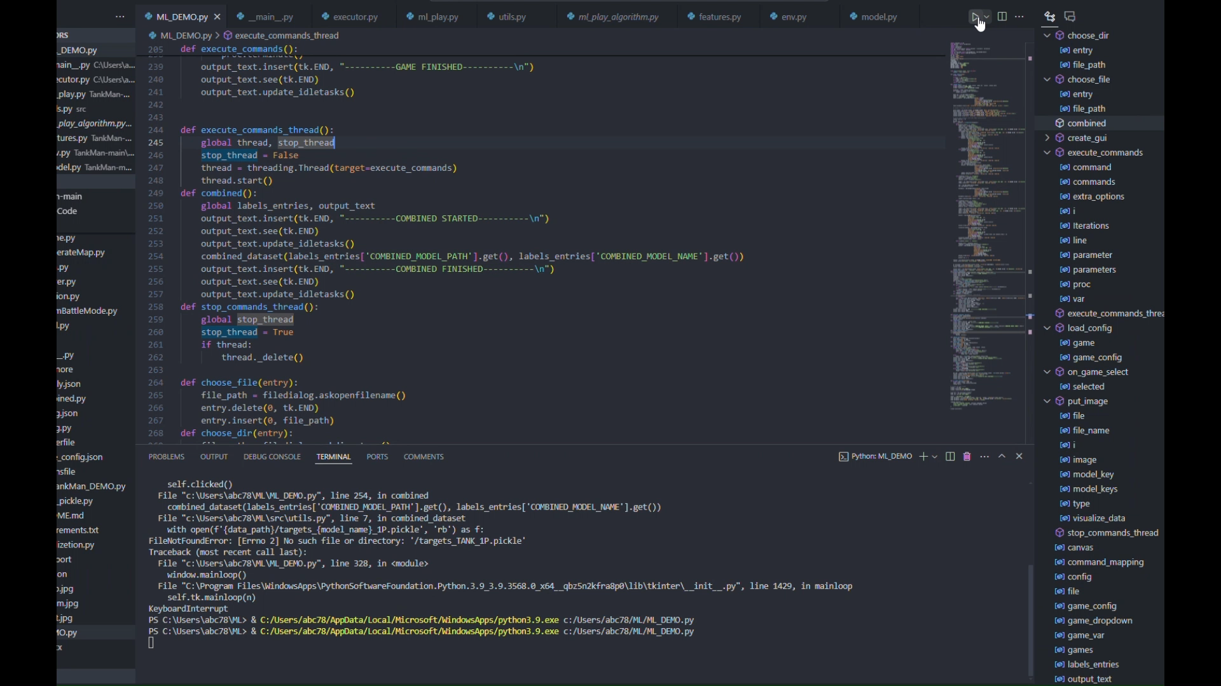
DEMO
啟動遊戲、開始訓練:

Slide 41
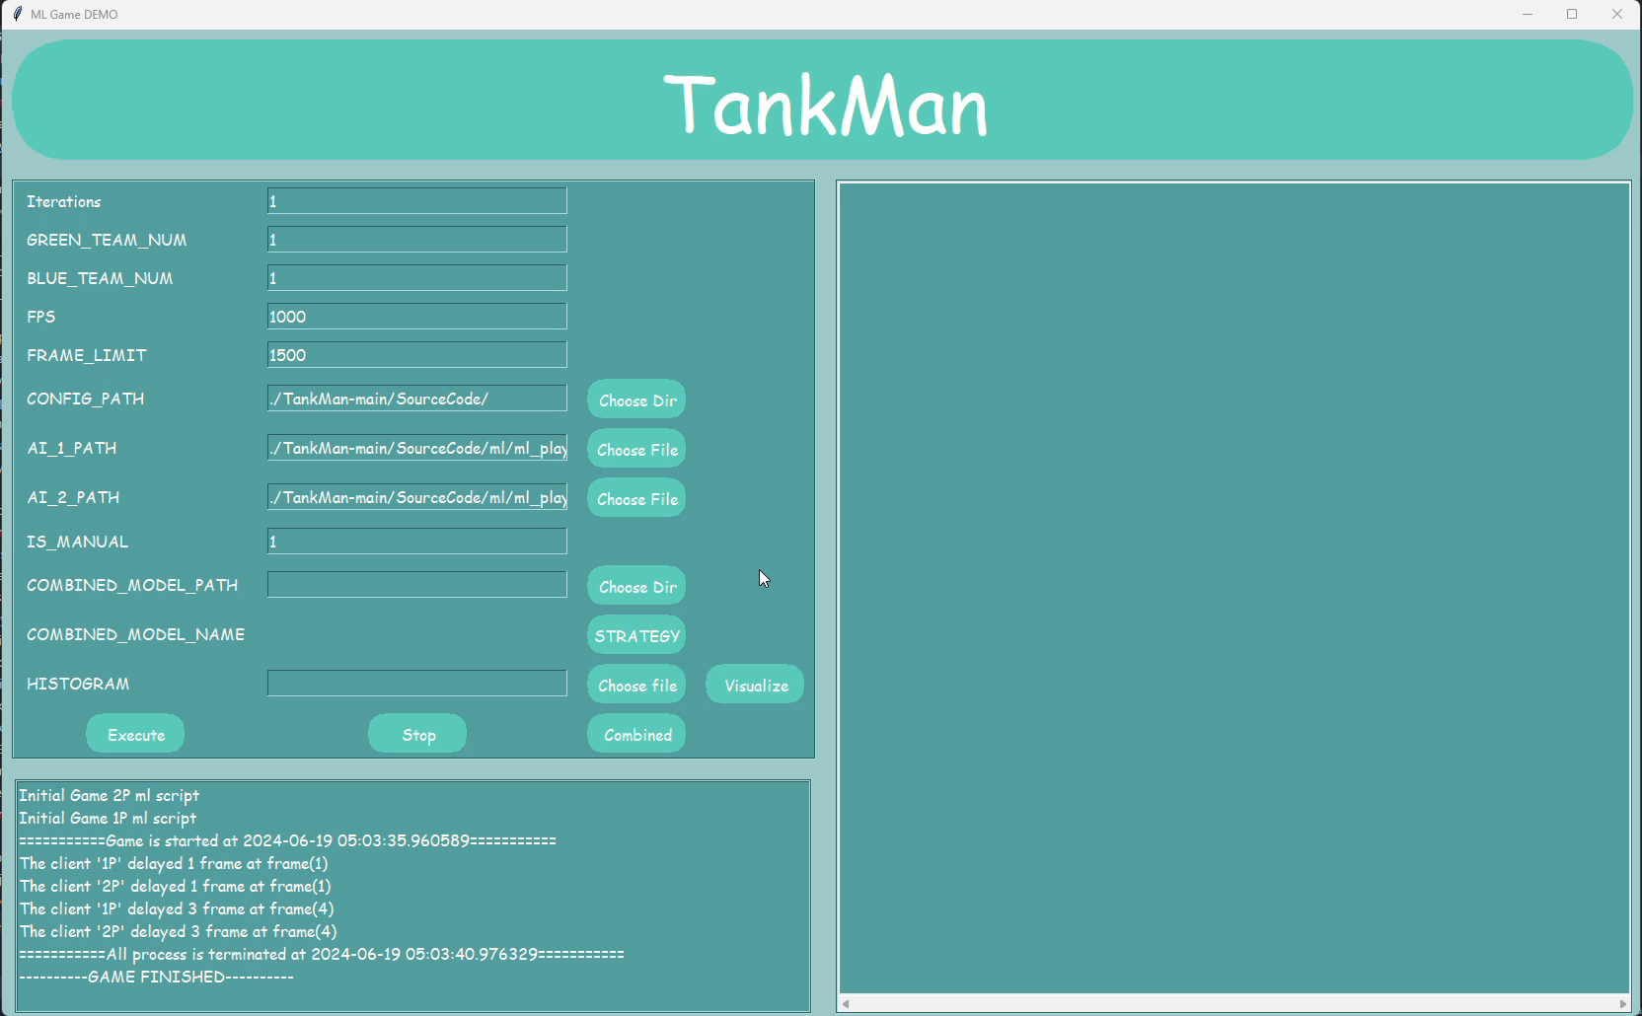
DEMO
資料可視化、合併:

Slide 42
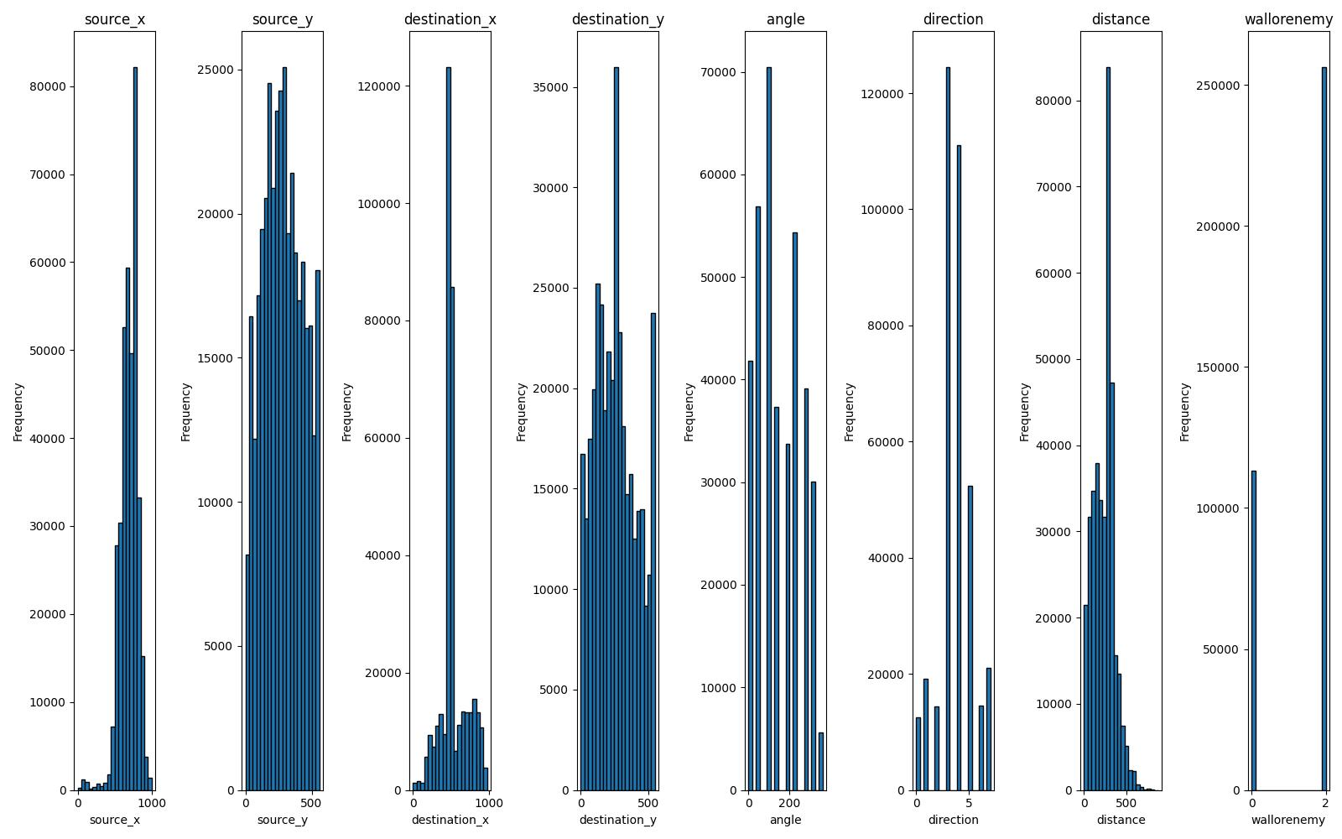
DEMO
資料視覺化、合併:
1P

Slide 43
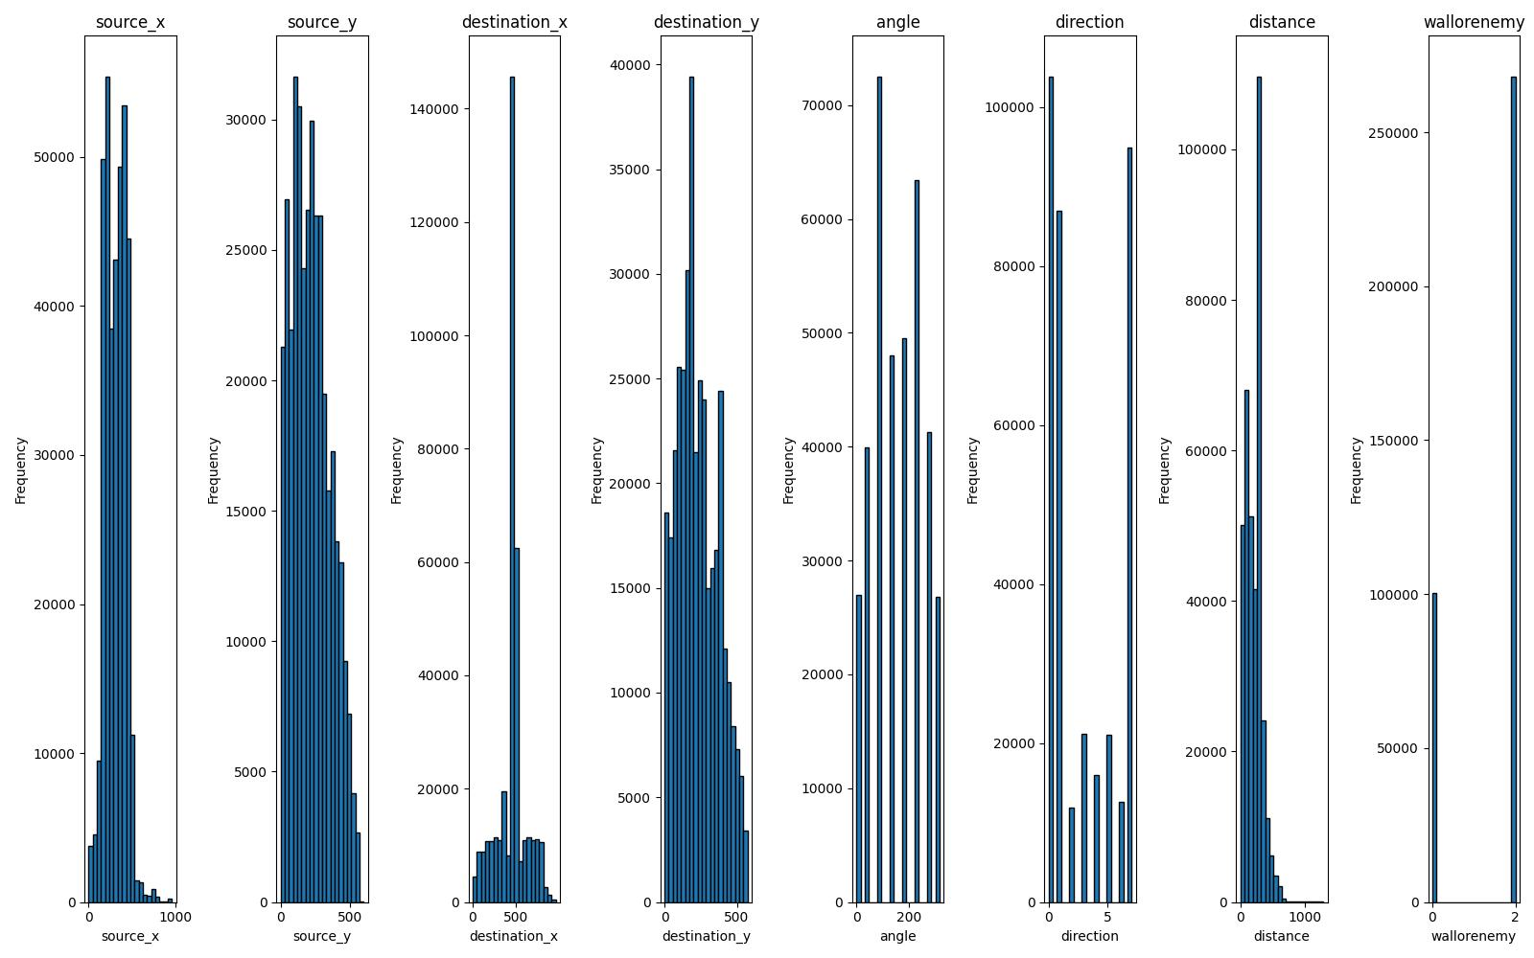
DEMO
資料視覺化、合併:
2P

Slide 44
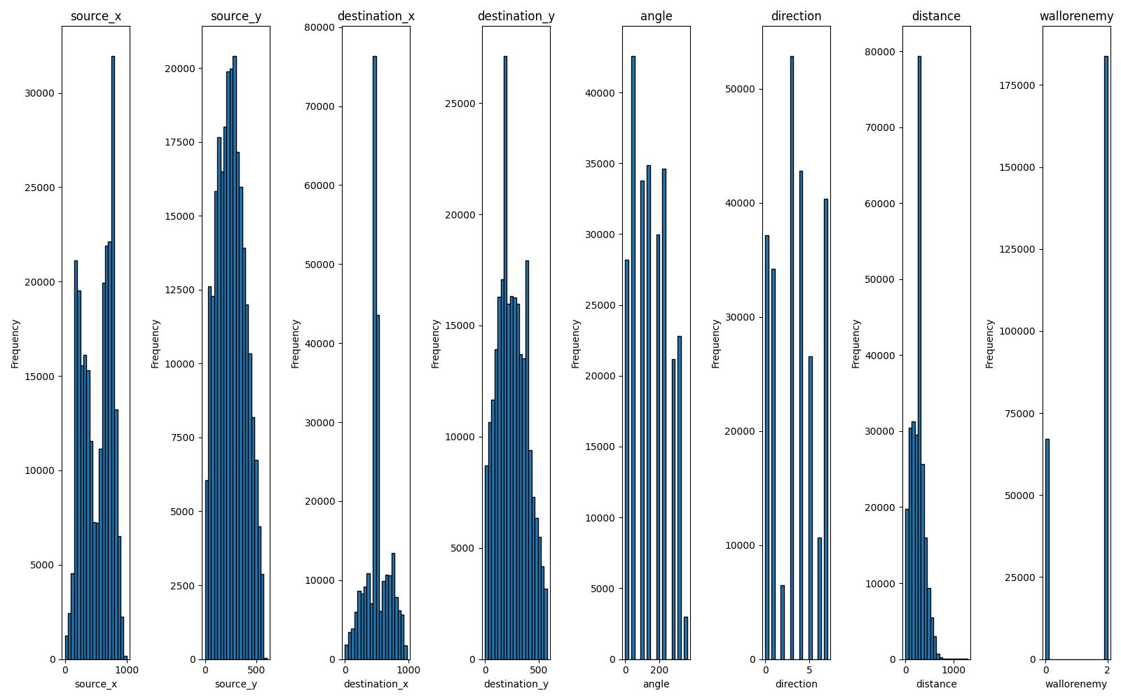
DEMO
資料視覺化、合併:
合併、排除重複項
由於牆壁導致特徵分佈不平均

Slide 45
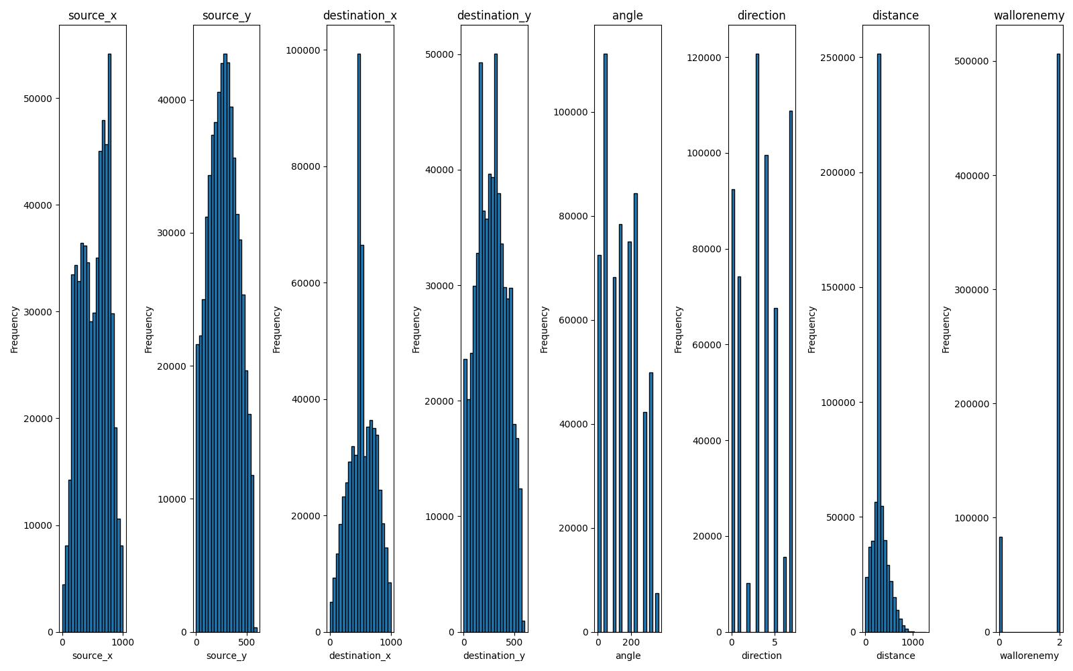
DEMO
資料視覺化、合併:
修改地圖訓練

Slide 46
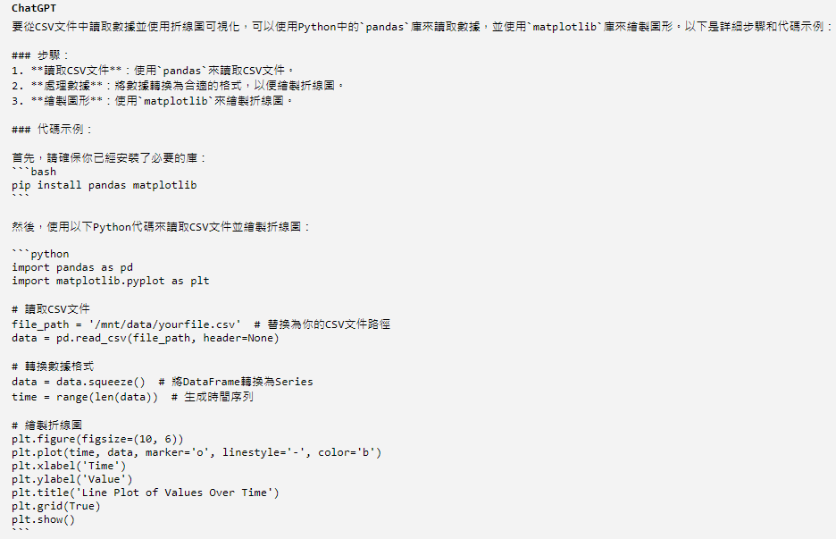
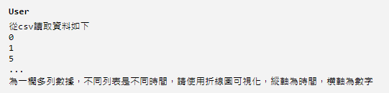
GPT
Line chart

Slide 47
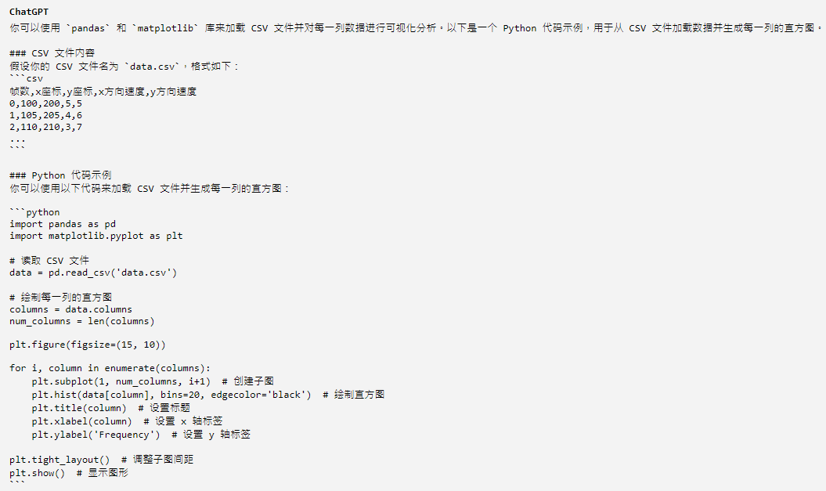
GPT
Histogram

Slide 48
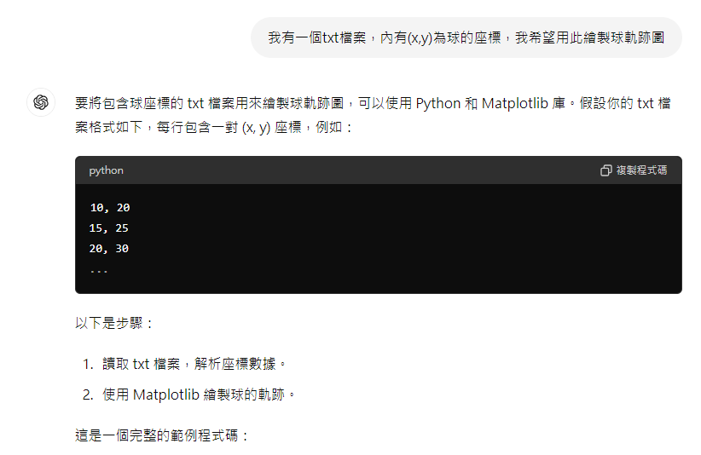
GPT
Heatmap

Slide 49
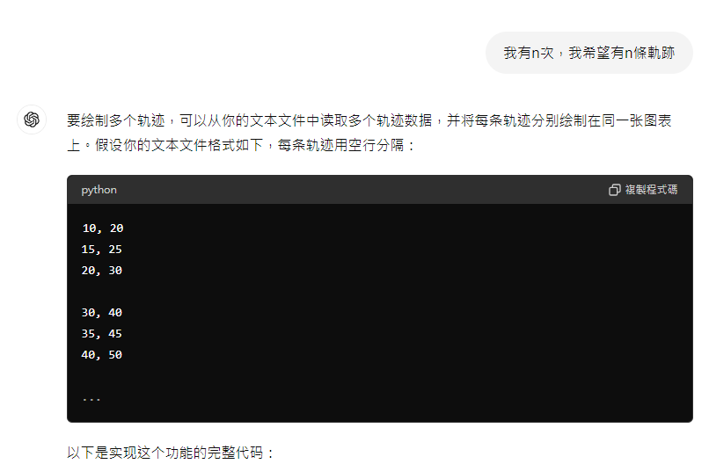
GPT
Heatmap

Slide 50
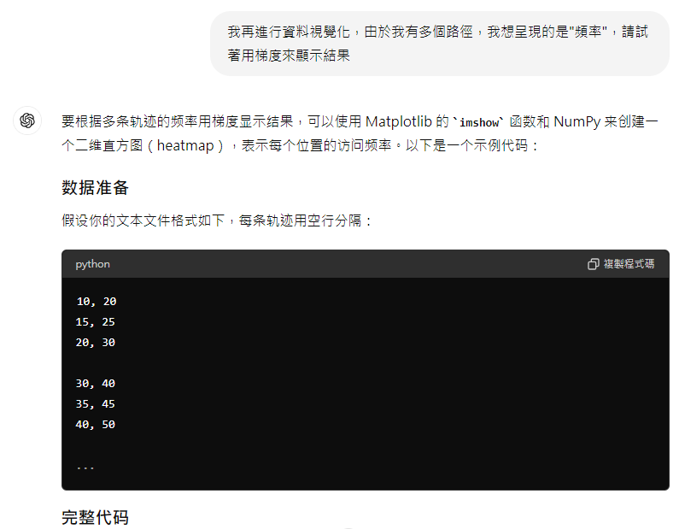
GPT
Heatmap

Slide 51
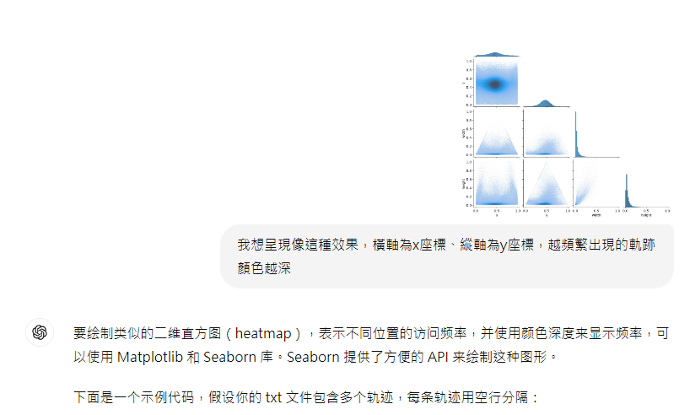
GPT
Heatmap

